Slide 1
Software Testing and Quality Assurance (CST-311)
Department:- Computer Science & Engineering
Unit -2
Chapter 2
Lecture 2.2

Slide 2
Contents
What is Black Box Testing?
Types of Black Box Testing
Tools used for Black Box Testing
Black Box Testing Techniques
How to do Black Box Testing Step-wise?
Functional Testing
Advantages of Functional Testing
Disadvantages of Functional Testing
Non-Functional Testing
How to capture Non-Functional Requirement

Slide 3
What is Black Box Testing?
It is defined as a testing technique in which functionality of the Application Under Test (AUT) is tested without looking at the internal code structure, implementation details and knowledge of internal paths of the software.
This type of testing is based entirely on software requirements and specifications.
In Black Box Testing we just focus on inputs and output of the software system without bothering about internal knowledge of the software program.

Slide 4
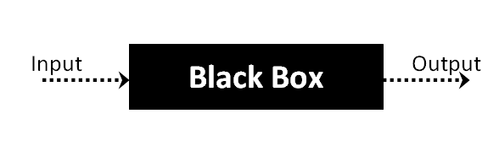
What is Black Box Testing?
The above Black-Box can be any software system you want to test. For Example, an operating system like Windows, a website like Google, a database like Oracle or even your own custom application. Under Black Box Testing, you can test these applications by just focusing on the inputs and outputs without knowing their internal code implementation.

Slide 5
Types of Black Box Testing
There are many types of Black Box Testing but the following are the prominent ones :-
Functional testing - This black box testing type is related to the functional requirements of a system; it is done by software testers.
Non-functional testing - This type of black box testing is not related to testing of specific functionality, but non-functional requirements such as performance, scalability, usability.
Regression testing - Regression Testing is done after code fixes, upgrades or any other system maintenance to check the new code has not affected the existing code.

Slide 6
Tools used for Black Box Testing
Tools used for Black box testing largely depends on the type of black box testing you are doing.
For Functional/ Regression Tests you can use - QTP, Selenium.
For Non-Functional Tests, you can use –
LoadRunner, Jmeter.

Slide 7
Black Box Testing Techniques
In order to systematically test a set of functions, it is necessary to design test cases. Testers can create test cases from the requirement specification document using the following Black Box Testing techniques.
Equivalence Partitioning
Boundary Value Analysis
Decision Table Testing
State Transition Testing
Error Guessing
Graph-Based Testing Methods
Comparison Testing

Slide 8
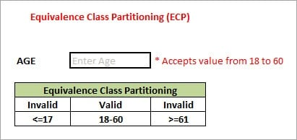
Black Box Testing Techniques
1. Equivalence Partitioning
This technique is also known as Equivalence Class Partitioning (ECP). In this technique, input values to the system or application are divided into different classes or groups based on its similarity in the outcome.
Hence, instead of using each and every input value we can now use any one value from the group/class to test the outcome. In this way, we can maintain the test coverage while we can reduce a lot of rework and most importantly the time spent.

Slide 9
Black Box Testing Techniques
As present in the above image, an “AGE” text field accepts only the numbers from 18 to 60. There will be three sets of classes or groups.
Two invalid classes will be:
a) Less than or equal to 17.
b) Greater than or equal to 61.
One valid class will be anything between 18 to 60.
We have thus reduced the test cases to only 3 test cases based on the formed classes thereby covering all the possibilities. So, testing with anyone value from each set of the class is sufficient to test the above scenario.
2. Boundary Value Analysis:-
From the name itself, we can understand that in this technique we focus on the values at boundaries as it is found that many applications have a high amount of issues on the boundaries.
Boundary means the values near the limit where the behavior of the system changes. In boundary value analysis both the valid inputs and invalid inputs are being tested to verify the issues.

Slide 10
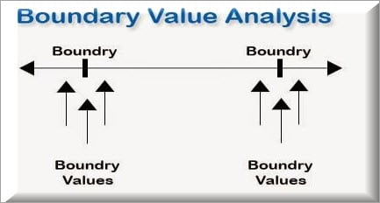
Black Box Testing Techniques
If we want to test a field where values from 1 to 100 should be accepted then we choose the boundary values: 1-1, 1, 1+1, 100-1, 100, and 100+1. Instead of using all the values from 1 to 100, we just use 0, 1, 2, 99, 100, and 101.

Slide 11
Black Box Testing Techniques
3. Decision Table Testing
As the name itself suggests that, wherever there are logical relationships like:
If { (Condition = True) then action1 ; } else action2; /*(condition = False)*/
Then a tester will identify two outputs (action1 and action2) for two conditions (True and False). So based on the probable scenarios a Decision table is carved to prepare a set of test cases.
For Example:
Take an example of XYZ bank that provides interest rate for the Male senior citizen as 10% and for the rest of the people 9%.

Slide 12
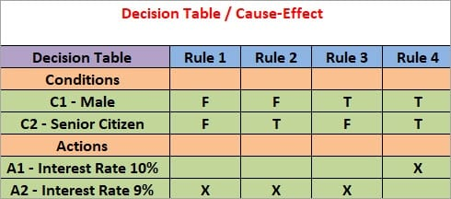
Black Box Testing Techniques
In this example condition, C1 has two values as true and false, condition C2 also has two values as true and false. The number of total possible combinations would then be four. This way we can derive test cases using a decision table.

Slide 13
Black Box Testing Techniques
4. State Transition Testing
State Transition Testing is a technique that is used to test the different states of the system under test.
The state of the system changes depending upon the conditions or events.
The events trigger states which become scenarios and a tester needs to test them.
A systematic state transition diagram gives a clear view of the state changes but it is effective for simpler applications.
More complex projects may lead to more complex transition diagrams thus making it less effective.

Slide 14
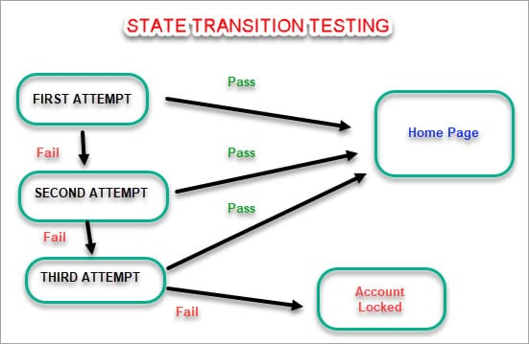
Black Box Testing Techniques

Slide 15
Black Box Testing Techniques
Error Guessing
In this technique, the tester can use his/her experience about the application behavior and functionalities to guess the error-prone areas. Many defects can be found using error guessing where most of the developers usually make mistakes.
Few common mistakes that developers usually forget to handle:
Divide by zero.
Handling null values in text fields.
Accepting the Submit button without any value.
File upload without attachment.
File upload with less than or more than the limit size.

Slide 16
Black Box Testing Techniques
6. Graph-Based Testing Methods
Each and every application is a build-up of some objects. All such objects are identified and the graph is prepared. From this object graph, each object relationship is identified and test cases are written accordingly to discover the errors.
7. Comparison Testing
Different independent versions of the same software are used to compare to each other for testing in this method.

Slide 17
How to do Black Box Testing Step-wise?
The general steps followed to carry out any type of Black Box Testing are:-
The black box test is based on the specification of requirements, so it is examined in the beginning.
In the second step, the tester creates a positive test scenario and an adverse test scenario by selecting valid and invalid input values to check that the software is processing them correctly or incorrectly.
In the third step, the tester develops various test cases such as decision table, all pairs test, equivalent division, error estimation, cause-effect graph, etc.
The fourth phase includes the execution of all test cases.
In the fifth step, the tester compares the expected output against the actual output.
In the sixth and final step, if there is any flaw in the software, then it is cured and tested again.

Slide 18
Functional Testing
This type deals with the functional requirements or specifications of an application. Here, different actions or functions of the system are being tested by providing the input and comparing the actual output with the expected output.
For Example, when we test a Dropdown list, we click on it and verify that it expands and all the expected values are showing in the list.
Few major types of Functional Testing are:
1. Unit Testing:
Unit testing is usually performed by a developer who writes different code units that could be related or unrelated to achieve a particular functionality.
This usually entails writing unit tests which would call the methods in each unit and validate those when the required parameters are passed, and its return value is as expected.

Slide 19
Functional Testing
Code coverage is an important part of unit testing where the test cases need to exist to cover the below three:
Line coverage
Code path coverage
Method coverage
2. Sanity Testing:- Testing that is done to ensure that all the major and vital functionalities of the application/system are working correctly. This is generally done after a smoke test.
3. Smoke Testing:- Testing that is done after each build is released to test to ensure build stability. It is also called as build verification testing.
4. Regression Tests:-Testing performed to ensure that adding new code, enhancements, fixing of bugs is not breaking the existing functionality or causing any instability and still works according to the specifications.
Regression tests need not be as extensive as the actual functional tests but should ensure just the amount of coverage to certify that the functionality is stable.

Slide 20
Functional Testing
5. Integration Tests:- When the system relies on multiple functional modules that might individually work perfectly, but have to work coherently when clubbed together to achieve an end to end scenario, validation of such scenarios is called Integration testing.
6. Beta/Usability Testing:- Product is exposed to the actual customer in a production like an environment and they test the product. The user’s comfort is derived from this and the feedback is taken. This is similar to that of User Acceptance testing.

Slide 21
Functional Testing Use Case Example
Take an online HRMS portal where the employee logs in with his user account and password. On the login page, there are two text fields for the username & password, and two buttons: Login and Cancel. Successful login takes the user to the HRMS home page and cancel will cancel the login.
Specifications are as shown below:
#1 ) The user id field takes a minimum of 6 characters, a maximum of 10 characters, numbers(0-9), letters(a-z, A-z), special characters (only underscore, period, hyphen allowed) and it cannot be left blank. User id must begin with a character or a number and not special characters.
#2) Password field takes a minimum of 6 characters, a maximum of 8 characters, numbers (0-9), letters (a-z, A-Z), special characters (all), and cannot be blank.

Slide 22
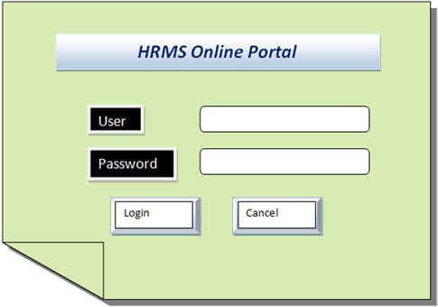
Functional Testing Use Case Example

Slide 23
Functional Testing Use Case Example
The basic approach to testing this scenario can be classified into two broad categories:
Positive testing and
Negative testing
Of course, each of these categories has its sub-section of tests that will be carried out.
Positive tests are happy path tests that are done to ensure that the product meets – at least the basic requirements that are vital to customer usage.
Negative scenarios ensure that the product behaves properly even when it is subjected to unexpected data.

Slide 24
Tests Conducted on Use Case Example
1. In Equivalence partitioning, the test data are segregated into various partitions called equivalence data classes. Data in each partition must behave in the same way, therefore only one condition needs to be tested. Similarly, if one condition in a partition doesn’t work, then none of the others will work.
For Example, in the above scenario the user id field can have a maximum of 10 characters, so entering data > 10 should behave the same way.
2. Boundary Value Tests
Boundary tests imply data limits to the application and validate how it behaves.
Therefore, if the inputs are supplied beyond the boundary values, then it is considered to be negative testing. So a minimum of 6 characters for the user sets the boundary limit. Tests written to have user id < 6 characters are boundary analysis tests.
.

Slide 25
Tests Conducted on Use Case Example
3. Decision-based Tests
Decision-based tests are centered around the ideology of the possible outcomes of the system when a particular condition is met.
In the above scenario given, the following decision-based tests can be immediately derived:
If the wrong credentials are entered, it should indicate that to the user and reload the login page.
If the user enters the correct credentials, it should take the user to the next UI.
If the user enters the correct credentials but wishes to cancel the login, then it should not take the user to the next UI and reload the login page.
4. Alternate Flow Tests
Alternate path tests are run to validate all the possible ways that exist, other than the main flow to accomplish a function.

Slide 26
Tests Conducted on Use Case Example
5. Ad-hoc Tests
When most of the bugs are uncovered through the above techniques, ad-hoc tests are a great way to uncover any discrepancies that are not observed earlier. These are performed with the mindset of breaking the system and see if it responds gracefully.
For Example, a sample test case would be:
A user is logged in, but the admin deletes the user account while he is performing some operations. It would be interesting to see how the application handles this gracefully.

Slide 27
Advantages of Functional Testing
This testing reproduces or is a replica of what the actual system is i.e. it is a replica of what the product is in the live environment. Testing is focused on the specifications as per the customer usage i.e. System specifications, Operating system, browsers, etc.
It does not work on any if and buts or any assumptions about the structure of the system.
This testing ensures to deliver a high-quality product that meets the customer requirement and makes sure that the customer is satisfied with the end results.
It ensures to deliver a bug-free product which has all the functionalities working as per the customer requirement.
Risk-based testing is done to decrease the chances of any kind of risk in the product.

Slide 28
Disadvantages of Functional Testing
There are many chances of performing redundant testing.
Logical errors can be missed out in the product.
This testing is based on the requirement, if in case the requirement is not complete or is complicated or is not clear, performing this testing in such a scenario becomes difficult and can be time-consuming too.

Slide 29
Non-Functional Testing
Non-functional testing is done to verify the non-functional requirement of the application like Performance, Usability, etc.
This testing has a greater impact on applications when it comes to the performance of the application under high user traffic. This testing ensures that your application is stable and is able to handle load under extreme conditions.
Example:
An application is developed and is completely tested for functionality, but non- functional testing is not performed on the same.
Meanwhile, when the application goes live, it might result in critical or major issues like when the load is increased on the application, it becomes too slow and takes a lot of time to open.
Response time might increase or when the load is increased to an extent, the application might crash. This shows how important it is to test an application's non-functional aspects.

Slide 30
Non-Functional Testing
Non-Functional requirements also capture the behavior when a large number of people are using the software at the same time. Most of the time it is experienced that the servers are busy or unavailable due to heavy load (i.e. more people are using it at the same time). Booking online railway tickets can be the best example of such a situation.
Hence documenting the Non-Functional requirement properly and performing the testing correctly will ensure high satisfaction in terms of usability by the potential customers.
Though this testing does not have a direct business impact on the functionality of the system, it can increase the user experience and user-friendliness to a higher extent which in turn will have a greater impact on the quality of the software.

Slide 31
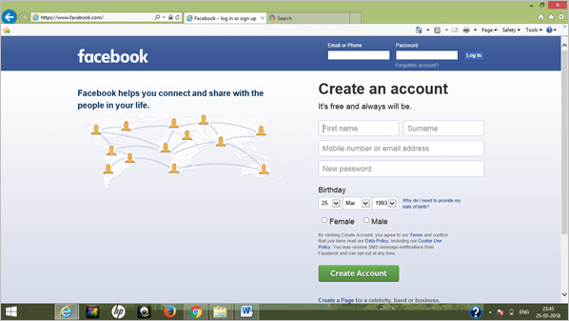
Non-Functional Testing
Example:

Slide 32
Non-Functional Testing
Consider the same Facebook login page example. In this case, the scope of Non-Functional testing is to note the time required by the system to log in to Facebook after entering the valid credentials.
Also, it can be tested as when (let’s say 100) the users log in at the same time, how much time does it take to log in the user on Facebook.
This ensures that the system can handle load and traffic which in turn has a good user experience.

Slide 33
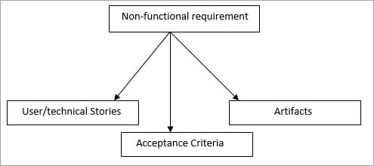
How to capture non-functional Requirement
A non-functional requirement should be captured as:
User /Technical Stories
In Acceptance criteria
In Artifact

Slide 34
How to capture non-functional Requirement
1. User /Technical Stories
A non-functional requirement can be captured using user stories or technical stories. Capturing Non-functional requirements as a user story is same as that of capturing any other requirement. The only difference in the user and a technical story is that the user story requires discussion and has visibility.
2. Acceptance Criteria
Acceptance Criteria is the point that is defined for accepting the product by the customer i.e. to get the product accepted to the defined points should be in pass state.
A non-functional requirement should be included in the acceptance criteria but sometimes it’s not possible to test the non-functional requirements with every story i.e. with every iteration. Hence, the requirements should be added or tested with the relevant iteration only.
3. In Artifacts
A separate artifact should be prepared for the non-functional requirements, this, in turn, would help to have a better idea of what needs to be tested and how it can be done in iterations.

Slide 35
Summary
Black Box Testing we just focus on inputs and output of the software system without bothering about internal knowledge of the software program.
Functional testing involves testing the different functions of the system by providing the input and comparing the actual output with the expected output.
Non-functional testing does not have a direct business impact on the functionality of the system, it can increase the user experience and user-friendliness to a higher extent which in turn will have a greater impact on the quality of the software.

Slide 36
References
Text Books:
CemKaner, Jack Falk, HungQuoc Nguyen, Testing Computer Software, Wiley, (Second Edition).
William E. Perry,“ Effective Methods for Software Testing”, John Wiley & Sons.
Boris Beizer, ”Software Testing Techniques”, Second Edition, Dreamtech.
Reference Books:
Rex Black, “Managing the Testing Process: Practical Tools and Techniques for Managing Hardware and Software Testing”.
Daniel Galin, “Software Quality Assurance from Theory to Implementation”, Pearson Education.

Slide 37
THANK YOU

